Slide 1
CPE 221: Computer Organization
15 Multicycle ARM Processor
rahul.bhadani@uah.edu

Slide 2
Multicycle ARM Processor​
Single-cycle:​
+ simple​
- cycle time limited by longest instruction (LDR)​
- separate memories for instruction and data​
- 3 adders/ALUs​ – ADDERS are expensive circuits
Multicycle processor addresses these issues by breaking instruction into shorter steps​
shorter instructions take fewer steps​
can re-use hardware​
cycle time is faster
read/write the memory/register or use the ALU
instruction read in one step, data written in a later step – thus need only single memory for instruction and data.
​

Slide 3
Multicycle ARM Processor​
Multicycle:​
+ higher clock speed​
+ simpler instructions run faster​
+ reuse expensive hardware on multiple cycles​
- sequencing overhead paid many times​
Same design steps as single-cycle: ​
first datapath ​
then control
In addition:
circuitry to store ​the intermediate results

Slide 4
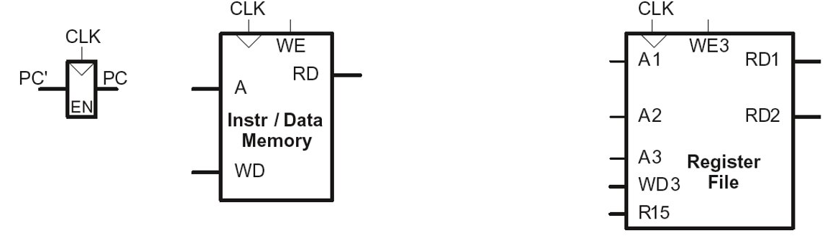
Multicycle State Elements​
Replace Instruction and Data memories with a single unified memory – more realistic​

Slide 5
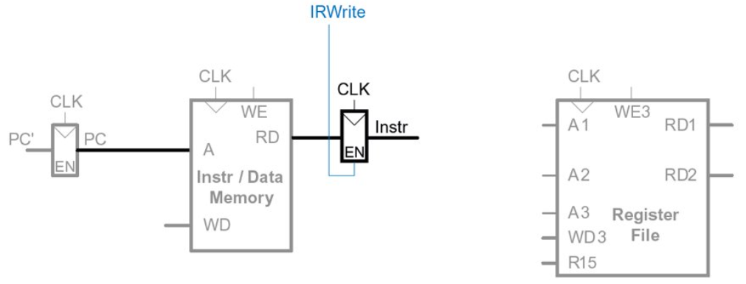
Instruction Register
The instruction is read and stored in a new non-architectural instruction register (IR) so that it is available for future cycles. The IR receives an enable signal, called IRWrite, which is asserted when the IR should be loaded with a new instruction.

Slide 6
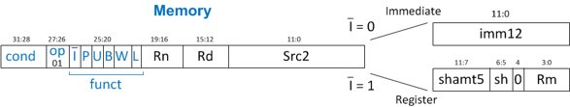
Multicycle Datapath: Instruction Fetch​
STEP 1: Fetch instruction​
LDR Rd, [Rn, imm12]​

Slide 7
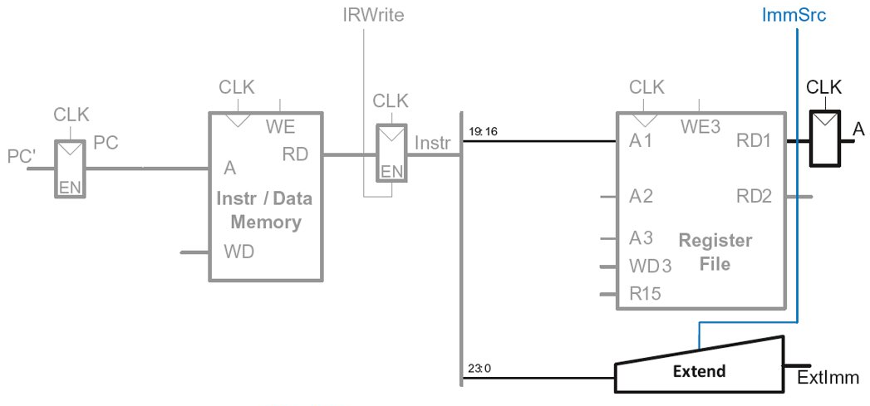
Multicycle Datapath: LDR Register Read​
STEP 2: Read source operands from RF​ LDR Rd, [Rn, imm12]​

Slide 8
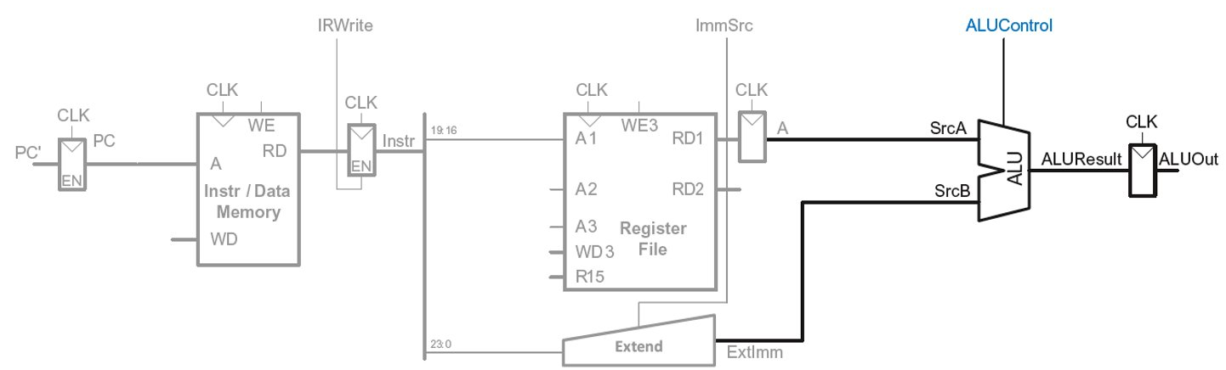
Multicycle Datapath: LDR Address​
STEP 3: Compute the memory address​
LDR Rd, [Rn, imm12]​

Slide 9
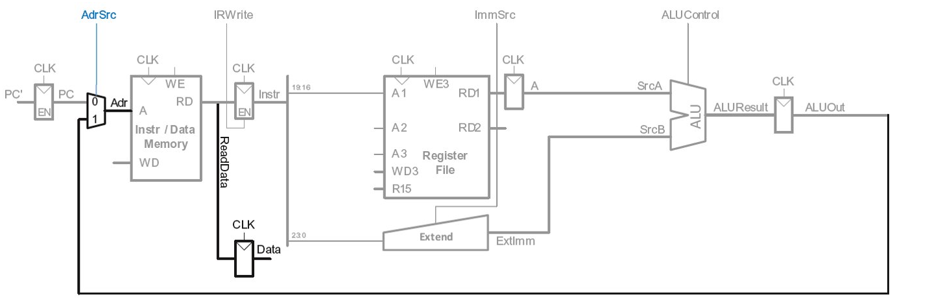
Multicycle Datapath: LDR Memory Read​
STEP 4: Read data from memory​ LDR Rd, [Rn, imm12]​

Slide 10
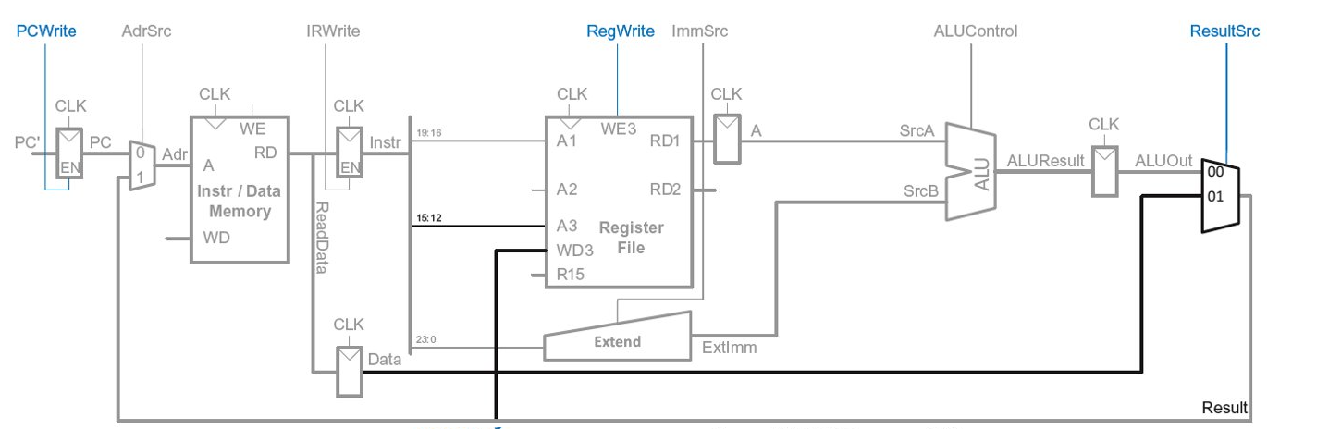
Multicycle Datapath: LDR Write Register​
STEP 5: Write data back to register file​ LDR Rd, [Rn, imm12]​

Slide 11
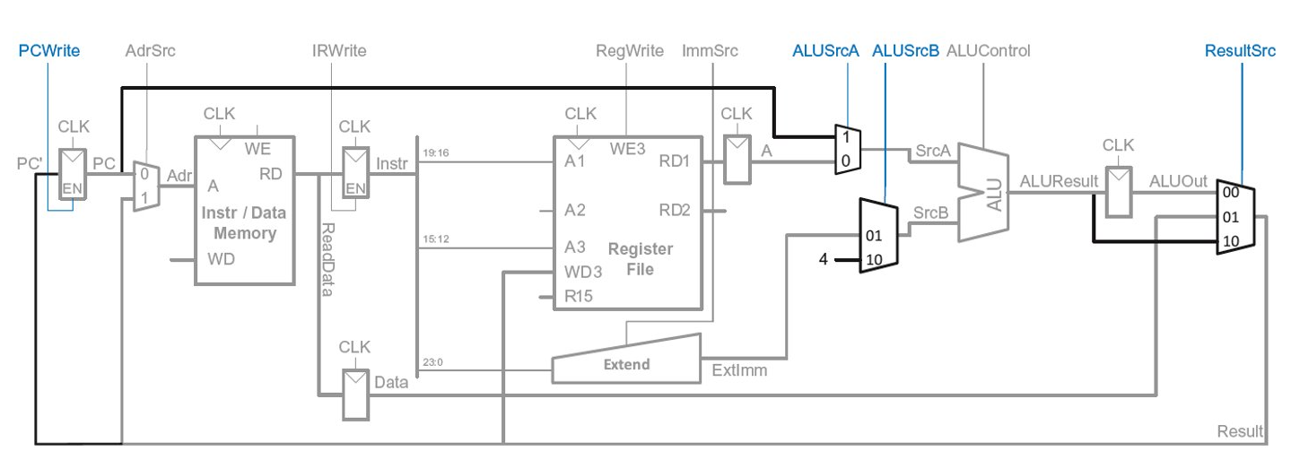
Multicycle Datapath: Increment PC​
STEP 6: Increment PC​

Slide 12
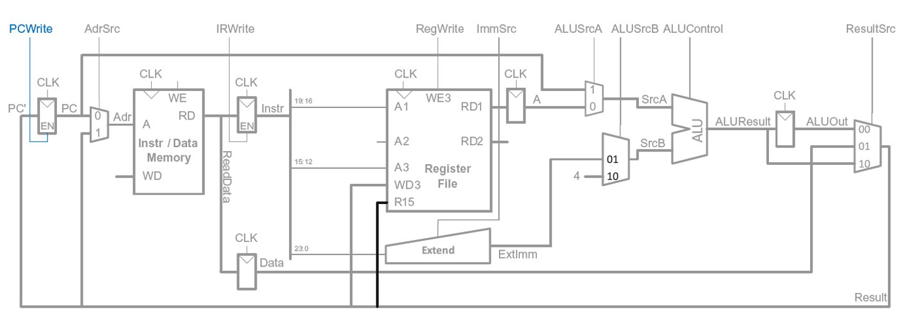
Multicycle Datapath: Access to PC​
PC can be read/written by instruction​

Slide 13
Multicycle Datapath: Access to PC​
PC can be read/written by instruction​
Read: R15 (PC+8) available in Register File​

Slide 14
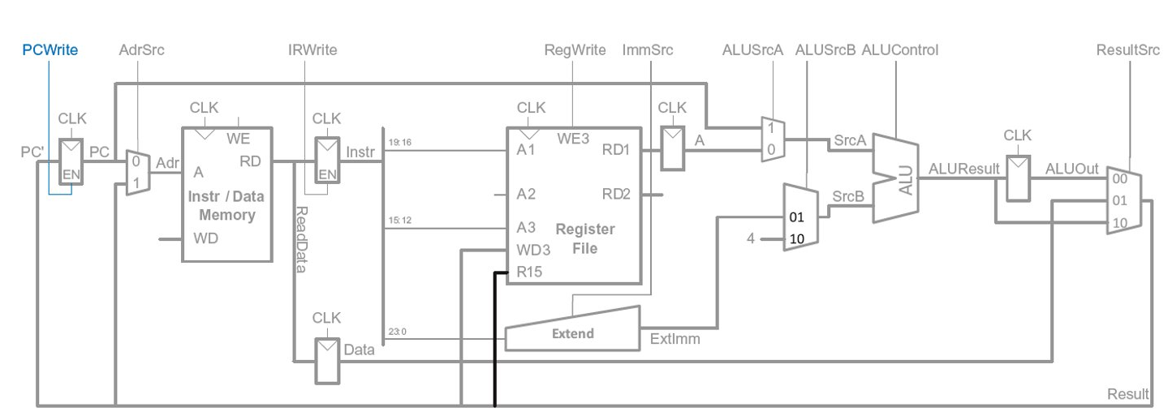
Multicycle Datapath: Read to PC (R15)​
Example: ADD R1, R15, R2​
R15 needs to be read as PC+8 from Register File (RF) in 2nd step​
So (also in 2nd step) PC + 8 is produced by ALU and routed to R15 input of RF

Slide 15
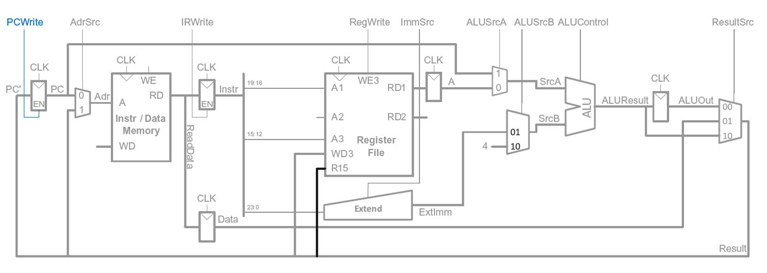
Multicycle Datapath: Access to PC​
PC can be read/written by instruction​
Read: R15 (PC+8) available in Register File​
Write: Be able to write result of instruction to PC​

Slide 16
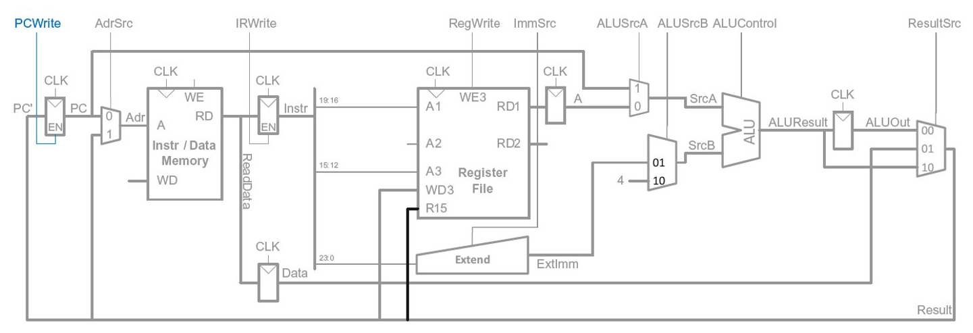
Multicycle Datapath: Write to PC (R15)​
Example: SUB R15, R8, R3
Result of instruction needs to be written to the PC register​
ALUResult already routed to the PC register, just assert PCWrite​
​

Slide 17
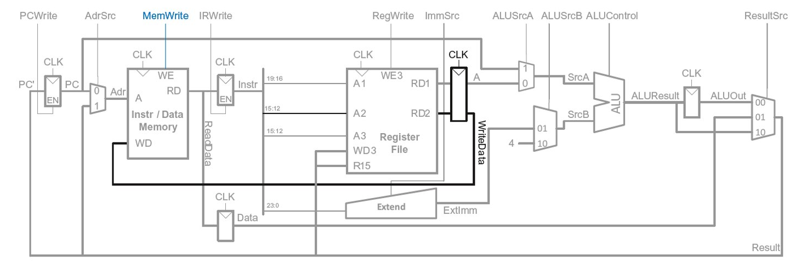
Multicycle Datapath: STR​
Write data in Rn to memory​

Slide 18
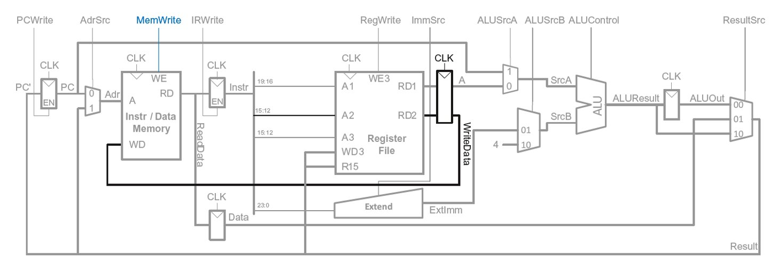
Multicycle Datapath: Data-processing​
With immediate addressing (i.e., an immediate Src2), no additional changes needed for datapath​

Slide 19
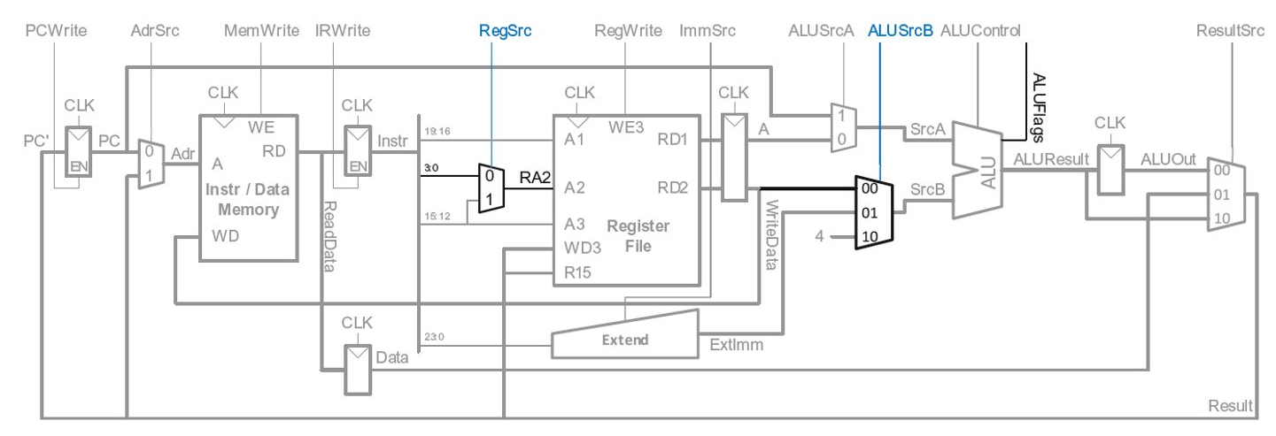
Multicycle Datapath: Data-processing​
With register addressing (register Src2):​
Read from Rn and Rm​

Slide 20
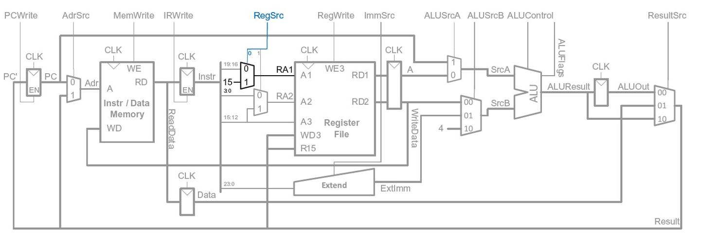
Multicycle Datapath: B​
Calculate branch target address: ​
BTA = (ExtImm) + (PC+8)​
ExtImm = Imm24 << 2 and sign-extended ​

Slide 21
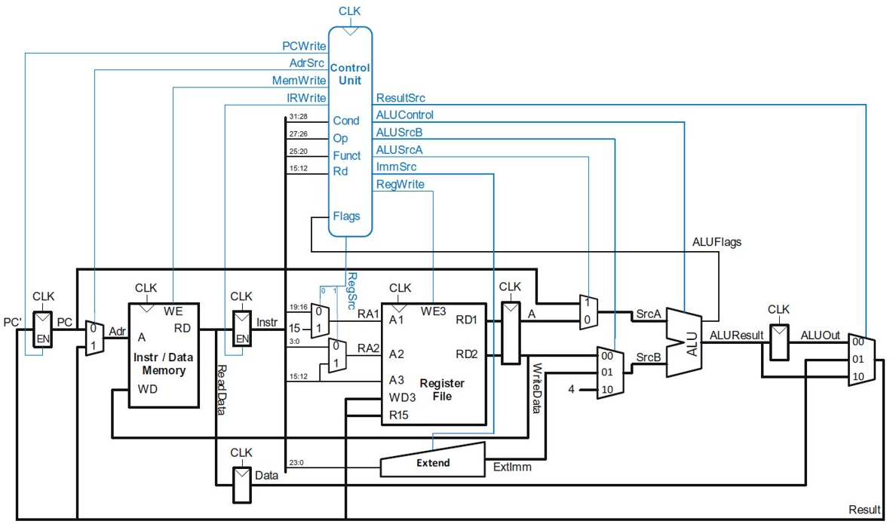
Multicycle ARM Processor​ (Control Unit)

Slide 22
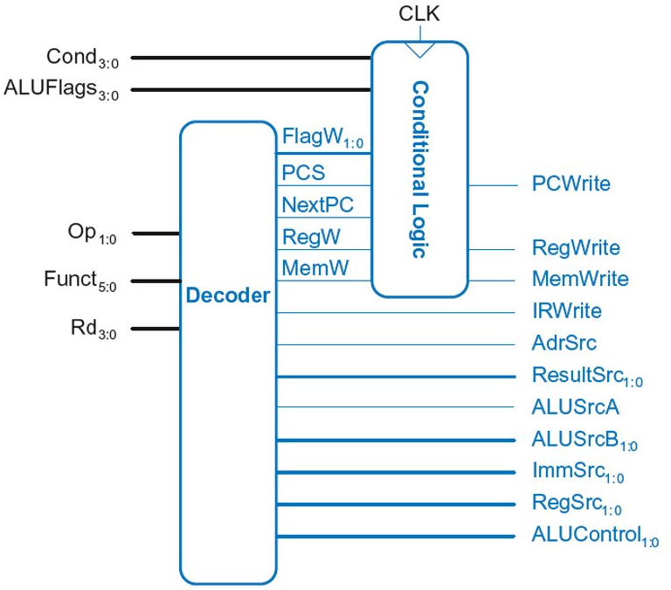
Multicycle Control​
First, discuss Decoder​
Then, Conditional Logic​

Slide 23
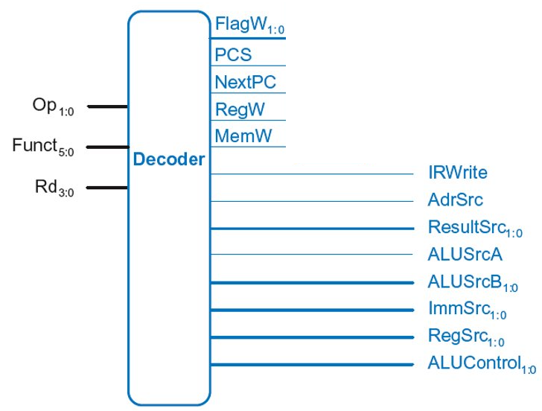
Multicycle Control: Decoder​

Slide 24
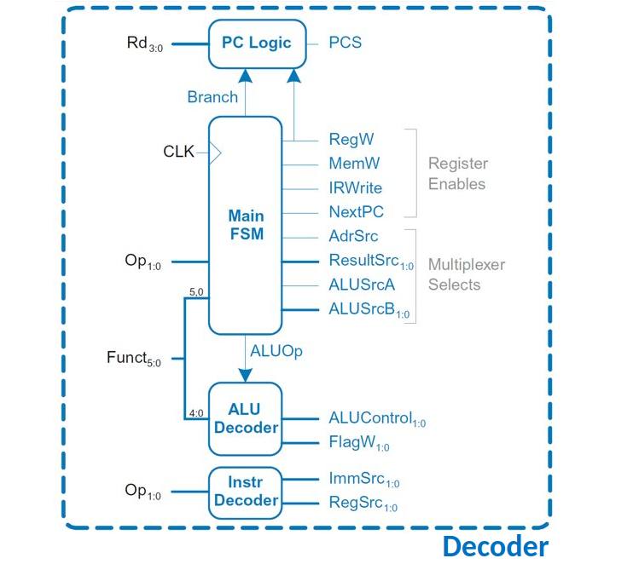
Multicycle Control: Unwrapping Decoder​
ALU Decoder and PC Logic same as single-cycle​

Slide 25
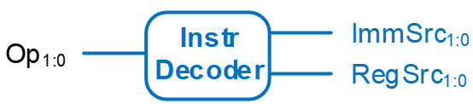
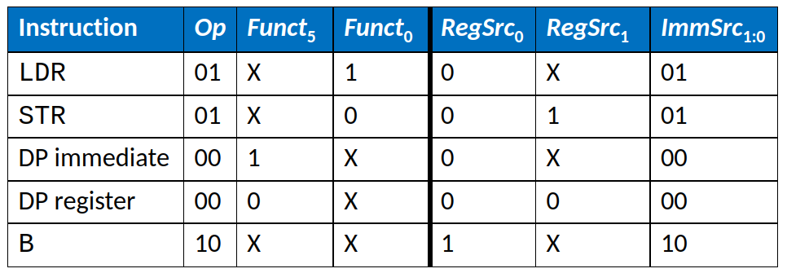
Multicycle Control: Instr Decoder​
RegSrc0 = (Op == 102)​
RegSrc1 = (Op == 012)​
ImmSrc1:0 = Op​

Slide 26
Multicycle Control: Main FSM​

Slide 27
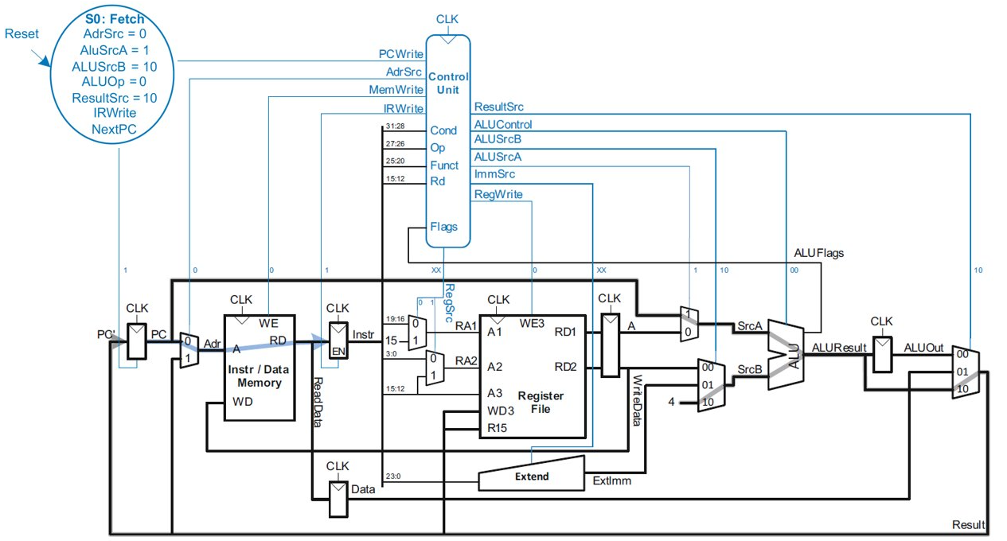
Main Controller FSM: Fetch​

Slide 28
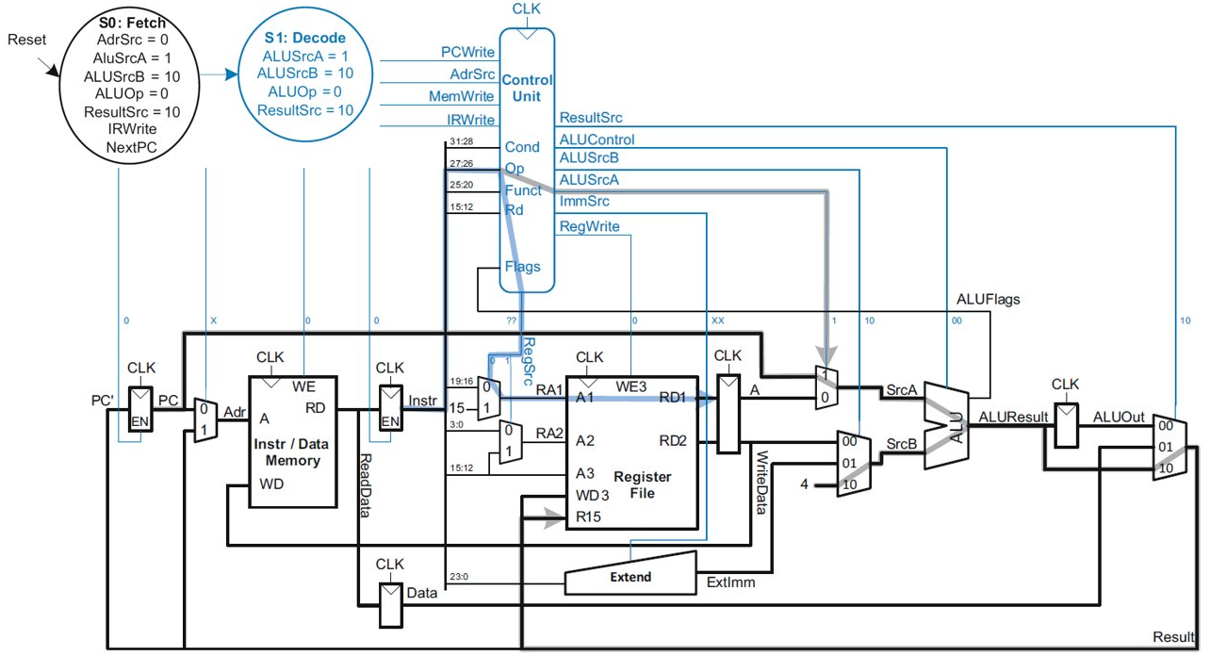
Main Controller FSM: Decode​

Slide 29
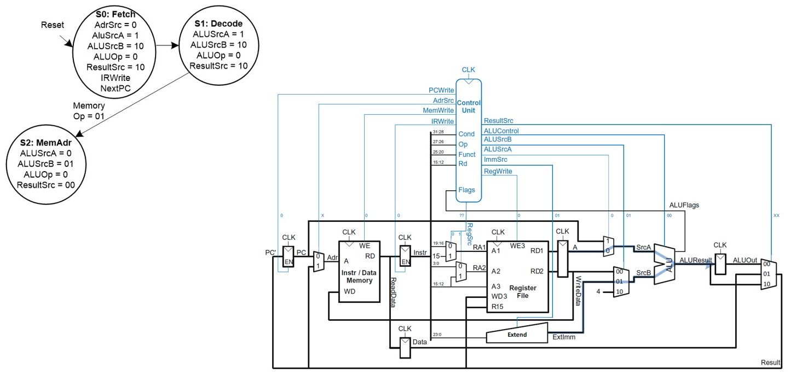
Main Controller FSM: Address​

Slide 30
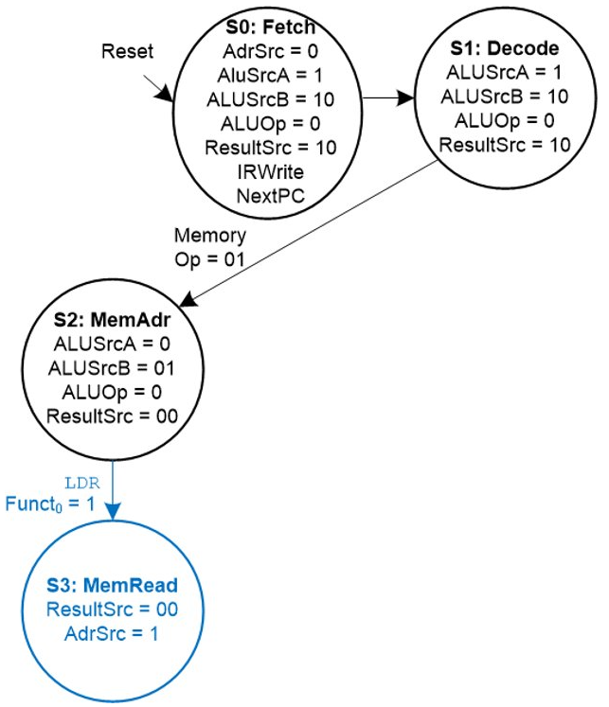
Main Controller FSM: Read Memory​

Slide 31
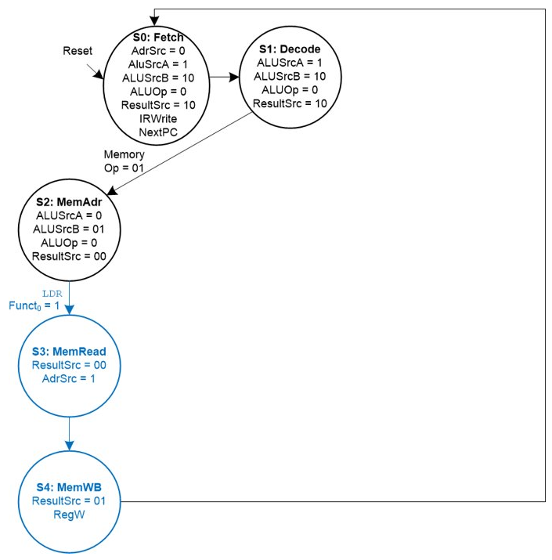
Main Controller FSM: LDR​

Slide 32
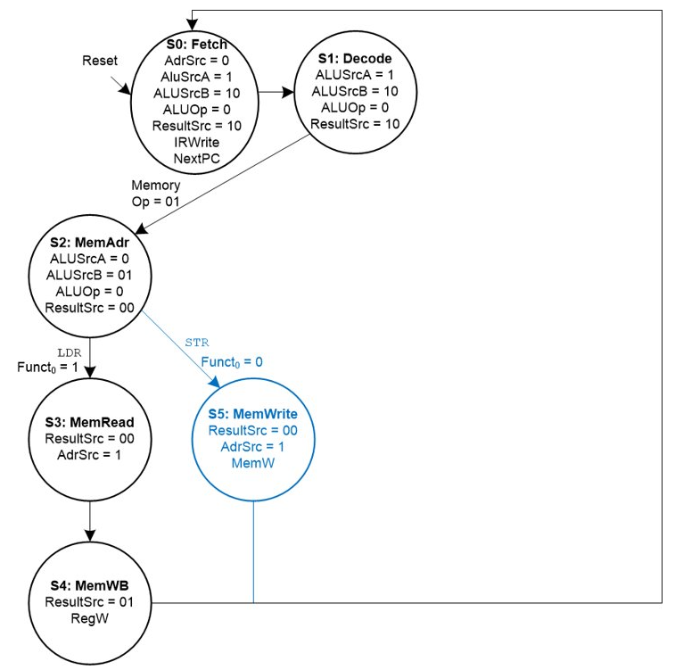
Main Controller FSM: STR​

Slide 33
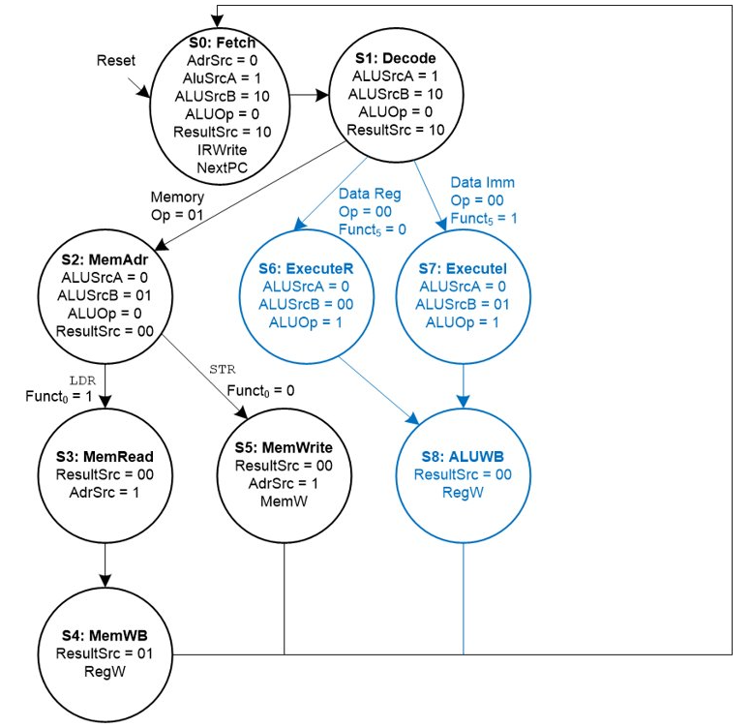
Main Controller FSM: Data-processing​

Slide 34
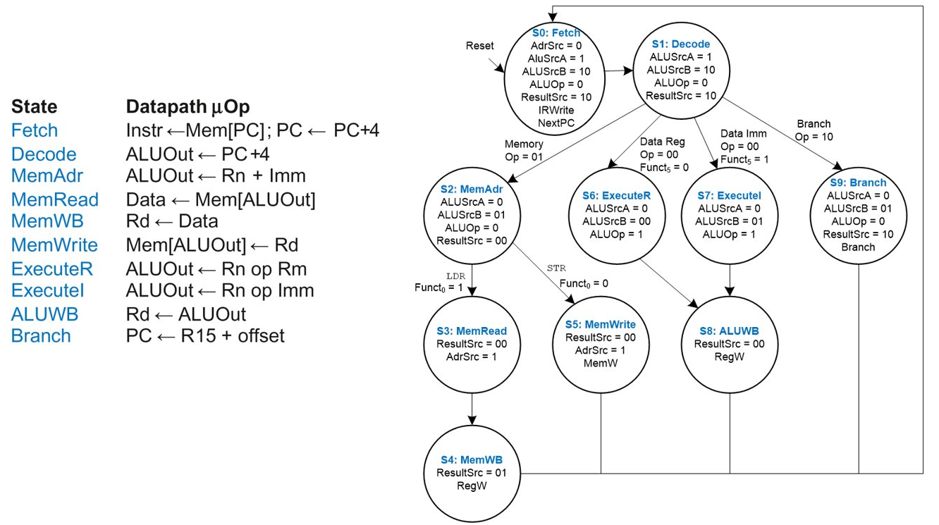
Multicycle Controller FSM​

Slide 35
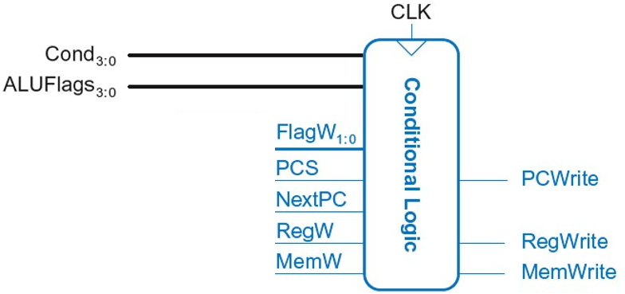
Multicycle Control: Cond. Logic​

Slide 36
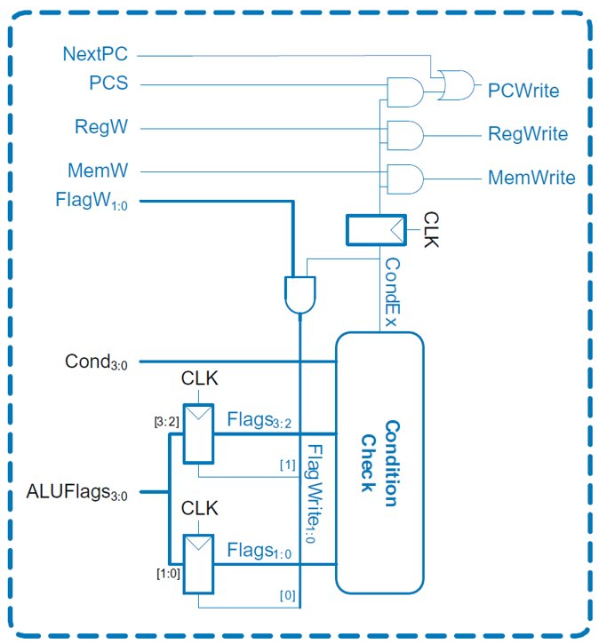
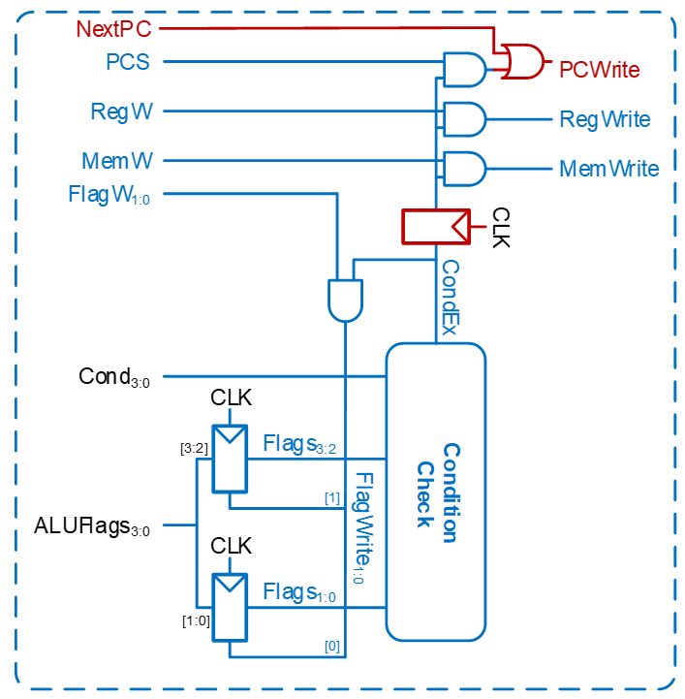
Single-Cycle vs Multi-cycle Conditional Logic​
PCWrite asserted in Fetch state​
​
ExecuteI/ExecuteR state:​
CondEx asserts ​
ALUFlags generated​
ALUWB state:​
Flags updated​
CondEx changes​
PCWrite, RegWrite, and ​
MemWrite don’t see ​
change till new ​
instruction (Fetch state)​
Single-Cycle
Multi-Cycle

Slide 37
Multicycle Processor Performance​
Instructions take different number of cycles:​
3 cycles: B​
4 cycles: DP, STR​
5 cycles: LDR​
CPI is weighted average​
SPECINT2000 benchmark: ​
25% loads​
10% stores ​
13% branches​
52% R-type​
​
Average CPI = (0.13)(3) + (0.52 + 0.10)(4) + (0.25)(5) = 4.12​
https://www.spec.org/cpu2000/CINT2000/

Slide 38
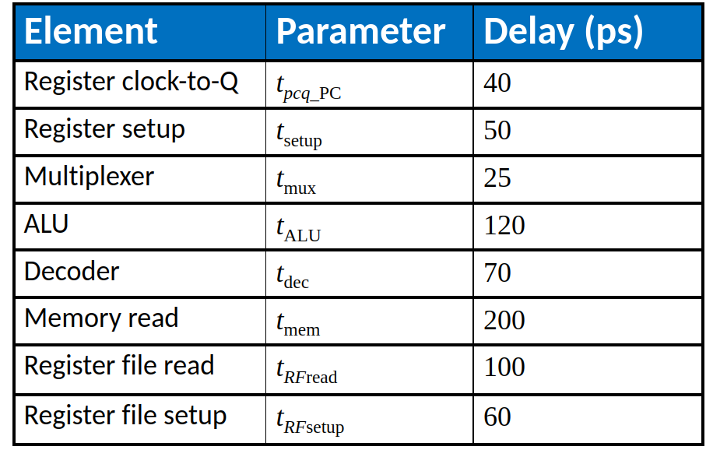
Multicycle Processor Performance​
Multicycle critical path:​
Assumptions:​
RF is faster than memory​
writing memory is faster than reading memory​
​
Tc₂ = tpcq + 2tmux + max(tALU + tmux, tmem) + tsetup​
Tc₂ = ?​
​

Slide 39
Multicycle Processor Performance​
Multicycle critical path:​
Assumptions:​
RF is faster than memory​
writing memory is faster than reading memory​
​
Tc₂ = tpcq + 2tmux + max(tALU + tmux, tmem) + tsetup​
Tc₂ = tpcq + 2tmux + max[tALU + tmux, tmem] + tsetup​
= [40 + 2(25) + 200 + 50] ps = 340 ps​

Slide 40
Multicycle Performance Example​
For a program with 100 billion instructions executing on a multicycle ARM processor​
CPI = 4.12 cycles/instruction​
Clock cycle time: Tc2 = 340 ps​
Execution Time = ?​

Slide 41
Multicycle Performance Example​
For a program with 100 billion instructions executing on a multicycle ARM processor​
CPI = 4.12 cycles/instruction​
Clock cycle time: Tc2 = 340 ps​
Execution Time = (# instructions) × CPI × Tc​
= (100 × 109)(4.12)(340 × 10-12)​
= 140 seconds
This is slower than the single-cycle processor (84 sec.)​

Slide 42
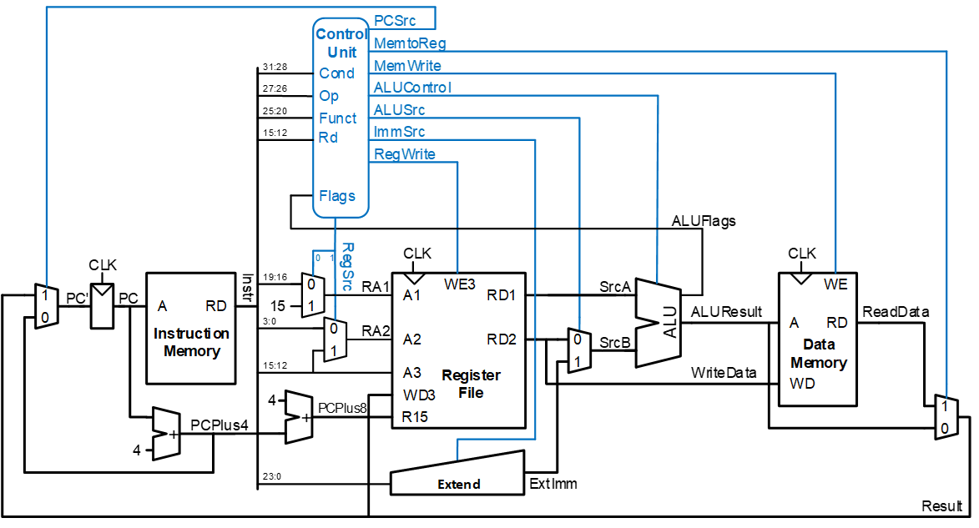
Recap Single-Cycle ARM Processor​

Slide 43

Recap Multicycle ARM Processor​

Slide 44
Side by Side
Single-Cycle
Multi-Cycle

